Slide 1

Buying & Selling services support – Interactive Sales Tool
Detailed Content

Slide 2
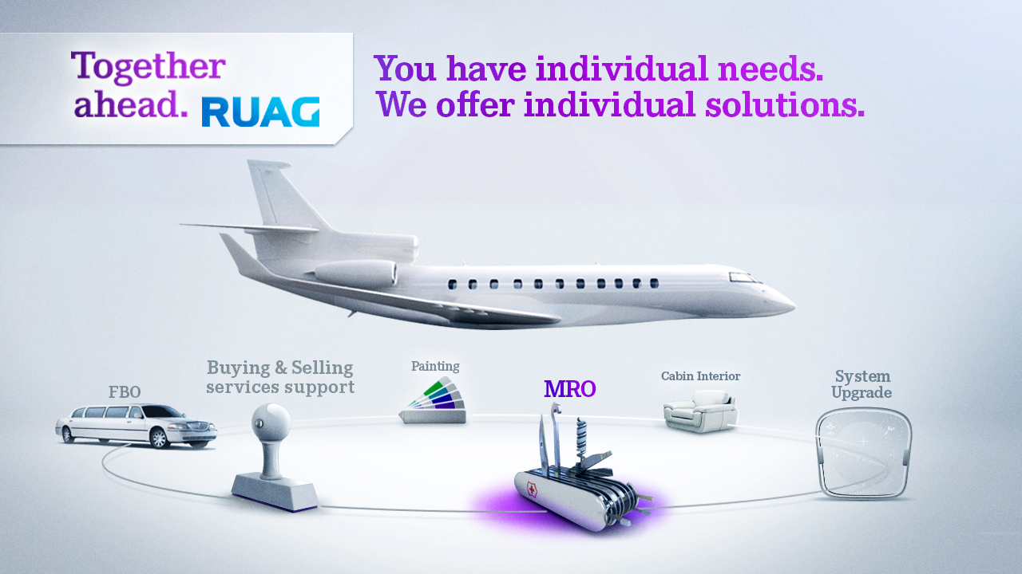

Slide 3
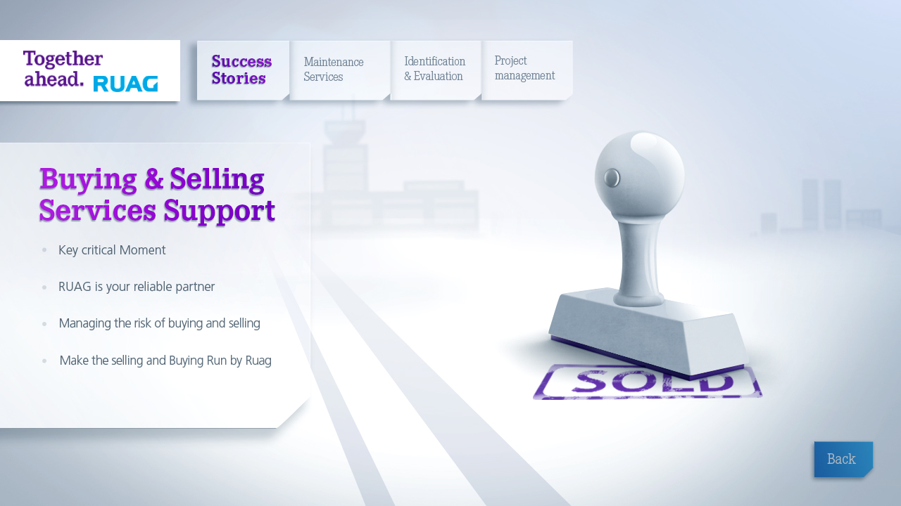

Slide 4
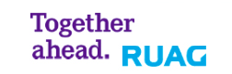
Services For Buyers / Identification & Evaluation
Identifying your desired aircraft
Comprehensive consultancy services
Evaluation by experienced personnel with deep technical knowledge
?Services
Examples
Success Story
Back

Slide 5
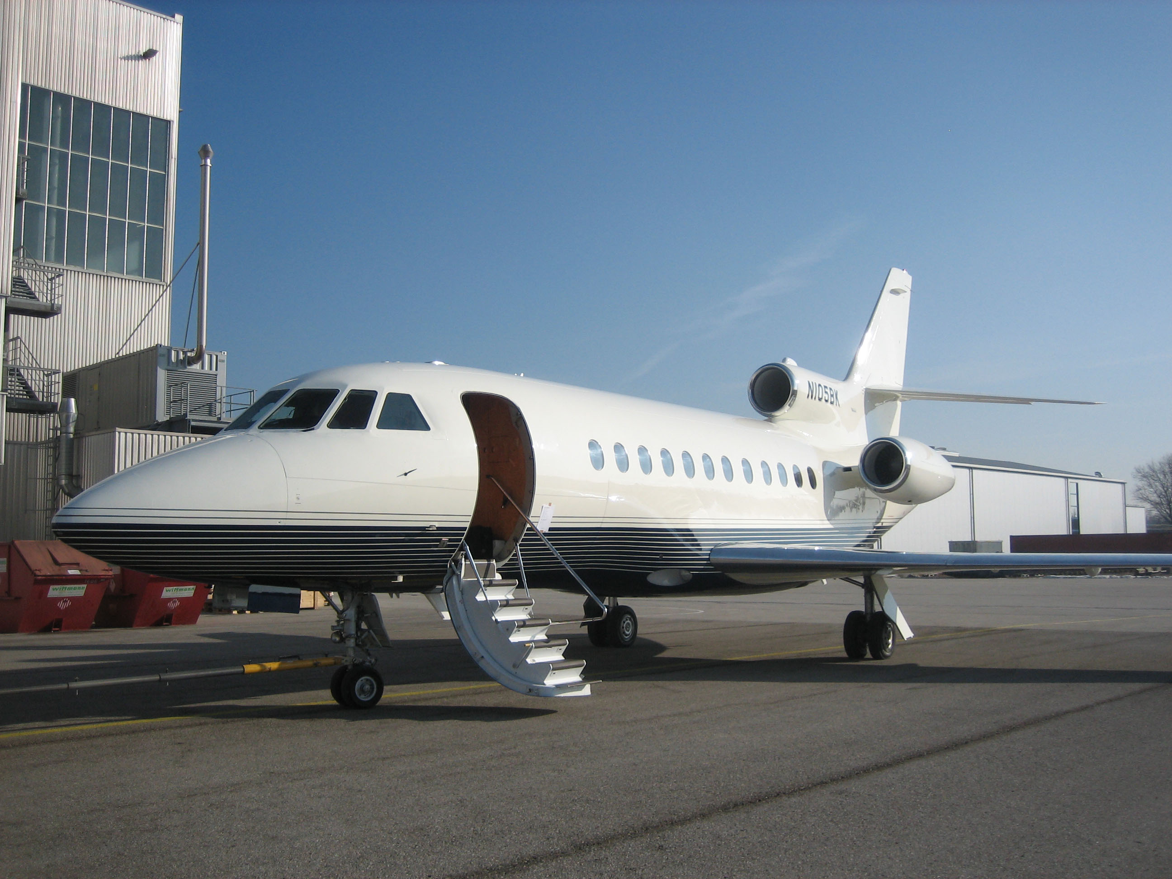
Services For Buyers / Identification & Evaluation - Examples
Back

Slide 6
Services For Sellers
With RUAG Aviation as your partner for buying & selling, the best possible selling price will be attained for your aircraft
Comprehensive consultancy services
Extensive experience and deep technical knowledge
Services?
Examples
Success Story
Back

Slide 7

Services For Buyers / Identification & Evaluation - Examples
Back

Slide 8
Project Management
Our goal is always to understand your needs and to create an individual solution for you
We offer complete project management, from identification of the desired aircraft to delivery
From consulting only to a complete package with project management, maintenance services, cabin interior refurbishment, system upgrades and a full paint service
Services
Examples
Success Story
Back

Slide 9

Project Management - Examples
Back

Slide 10
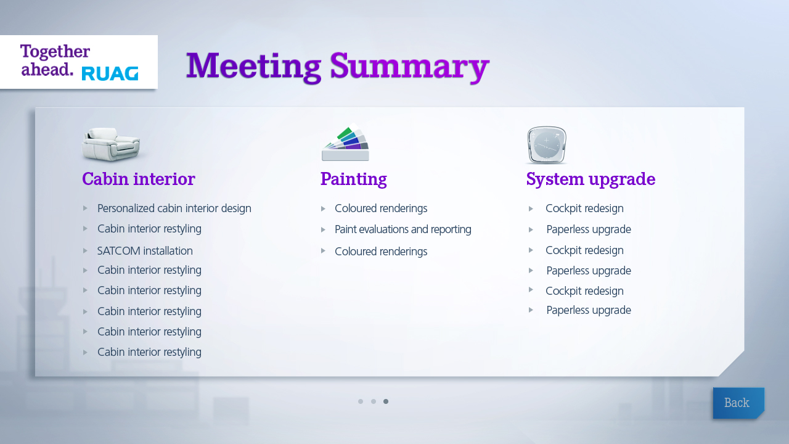

Slide 11
Thank You

